Slide 1

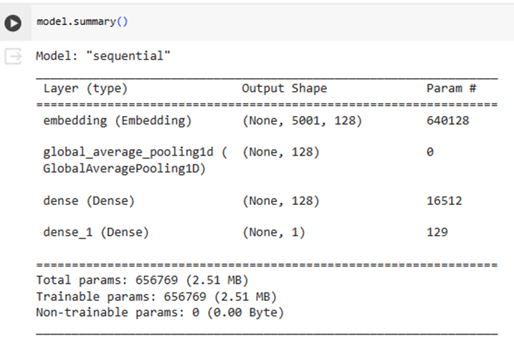
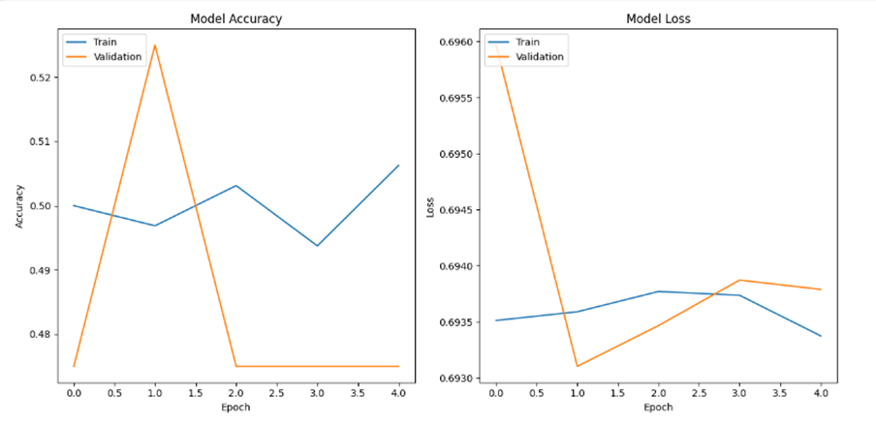
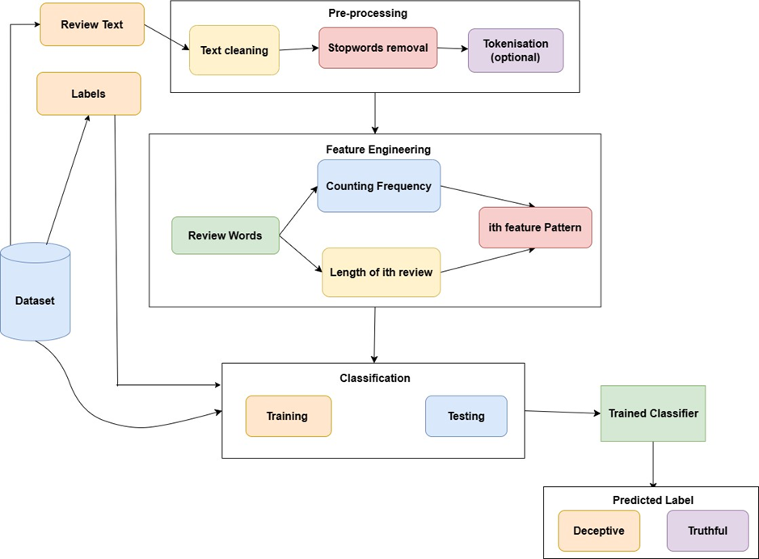
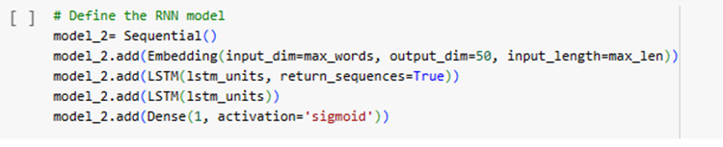
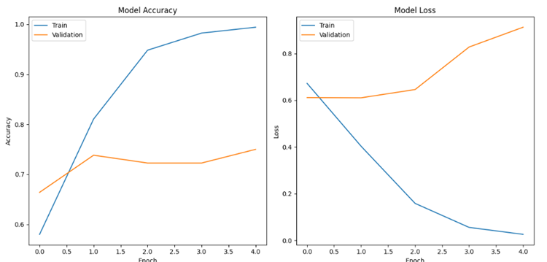
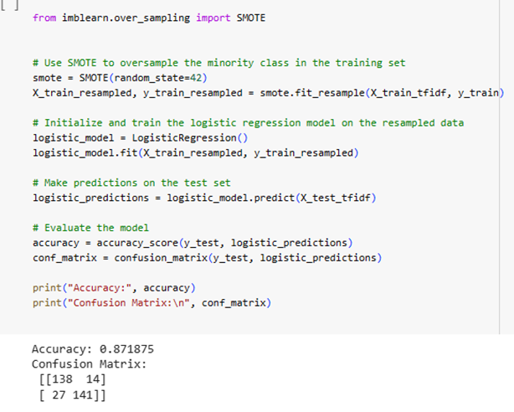
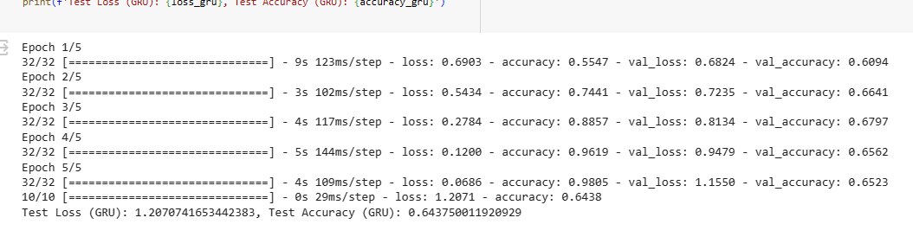
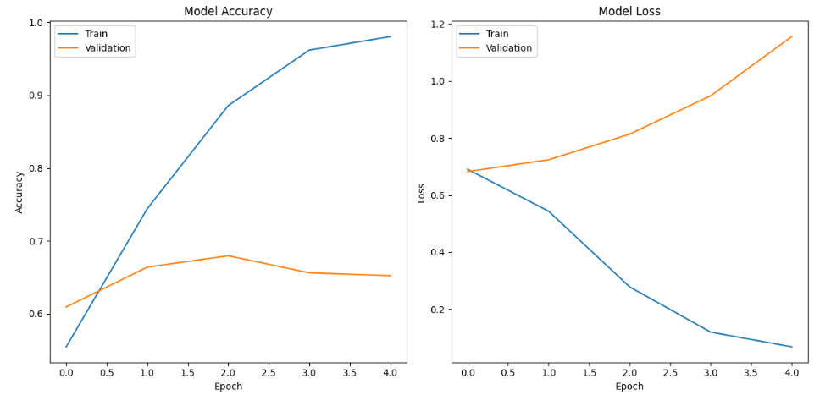
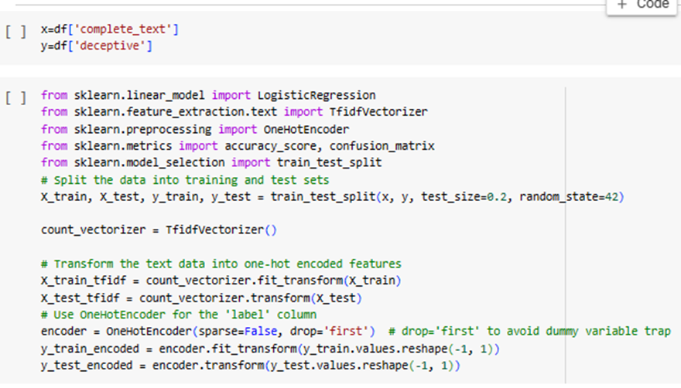
Fake reviews detection using Machine Learning Algorithms Sneha Nair, Pratima Chinta Amrita Vishwa Vidyapeetham
[A] GOAL AND CONTRIBUTIONS
[F] HYPER PARAMETERS CNN
Identify the best machine learning/deep learning algorithm for detecting fake hotel reviews. Comparing the performance of individual models and employing ensemble learning to boost accuracy and robustness.
Contribute to building a more trustworthy online marketplace by empowering consumers with reliable information
S.NO | Hyper Parameters | CNN
1. | Learning Rate | 0.001
2. | Number of Epochs | 5
3. | Batch size | 32
4. | Number of convolution layers | 3
5. | Number of kernals | 64
6. | Kernal size | (3,3)
7. | Stride | (1,1)
Keywords: Deep learning , Ensemble learning , Opinion spam detection ,
Machine learning algorithms
[B] MODEL DIAGRAM
[g] HYPER PARAMETERS LSTM
S.No | Hyper parameter | LSTM
1. | Units | None
2. | Activation function | Tanh
3. | Recurrent dropout | 0.0
4. | Kernal initializer | Glorot uniform
5. | Bias initializer | 0
6. | State initializer | Orthogonal
7. | Kernal regularizer | None
[C] DATASET DESCRIPTION
The dataset includes 1600 hotel reviews (20 per hotel, top 20 in Chicago) sourced from Kaggle, TripAdvisor, etc. Reviews are labeled "genuine" or "fake" based on sentiment (positive/negative) and truthfulness (deceptive/truthful). Each review has columns for source, hotel name, text, and sentiment polarity. Statistics on data size, distribution, and missingness are provided. This dataset is valuable for research on sentiment analysis, hotel reputation, and online fraud detection, acknowledging limitations due to potential biases and sampling methods.
Dataset link : https://www.kaggle.com/code/sachinsharma1123/deceptive-reviews-classification-acc-91/input
[H] HYPER PARAMETERS GRU
[D] NOISE REMOVAL( SMOTE)
S.No | Hyper parameter | gru
1. | Units | None
2. | Activation function | Tanh
3. | Recurrent dropout | 0.0
4. | Kernal initializer | Glorot uniform
5. | Bias initializer | 0
6. | State initializer | Orthogonal
7. | Kernal regularizer | None
SMOTE (Synthetic Minority Over-sampling Technique) is a technique used to address class imbalance in classification problems by oversampling the minority class. By generating synthetic samples, SMOTE effectively increases the number of instances in the minority class, making it closer in size to the majority class. This helps prevent the machine learning model from being biased toward the majority class and improves its ability to generalize well to unseen data.
[ I ] ACCURACY
[E] ONE HOT ENCODING
SR .NO | MODEL | EPOCHS | VALIDATION ACCURACY
1. | CNN | 10 | 0.80
2. | LSTM | 10 | 0.74
3. | GRU | 10 | 0.64
One-hot encoding is a method for representing categorical variables as binary vectors. Each category is represented by a binary vector, with a 1 in the position corresponding to the category and 0 in all other positions. One Hot Encoder is used to convert categorical labels (y_train and y_test) into one-hot encoded vectors.
fit_transform is used on the training labels to fit the encoder and transform the training labels.
transform is used on the test labels to transform them using the categories learned from the training set.
[J] REFERENCES
DETECTING FAKE ONLINE REVIEWS USING SUPERVISED AND SEMISUPERVISED LEARNING
An UGC-CARE Approved Group-II Journal www.ijearst.co.in.
INTERNATIONAL JOURNAL OF ENGINEERING IN ADVANCED RESEARCH SCIENCE AND TECHNOLOGY Volume.01, IssueNo.03, April-2022, Pages: 696-703
Authors: Mr .B .B. K. Prasad1 , B. Naga Siva Likhitha2 , K.Ramesh3
2. International Journal for Research in Applied Science & Engineering Technology
(IJRASET) ISSN: 2321-9653; IC Value: 45.98; SJ Impact Factor: 7.538 Volume 10 Issue
IV Apr 2022- Available at www.ijraset.com
SJ Impact Factor 7.538 | ISRA Journal Impact Factor 7.894 | 1973 Research Paper on Fake Online Reviews Detection using Semi-supervised and Supervised learning
Authors: Ajanta Chettri , Amal George , Dr. A. Rengarajan , Feon Jaison , School of CS and IT, Jain University, Bangalore , Professor, School of CS and IT, Jain University, Bangalore

